Slide 1

Imagining a Picture
Listen to the sound recording twice:
  First listening (for gist): “What does the speaker talk about?”
  Second listening (for details):
  “Take notes on aspects that describe the picture.”
Draw a sketch of Banksy’s picture with the information from the second listening.
Compare your sketch to Banksy‘s actual painting.
Your sketch of Banksy‘s “Game Changer”

Slide 2
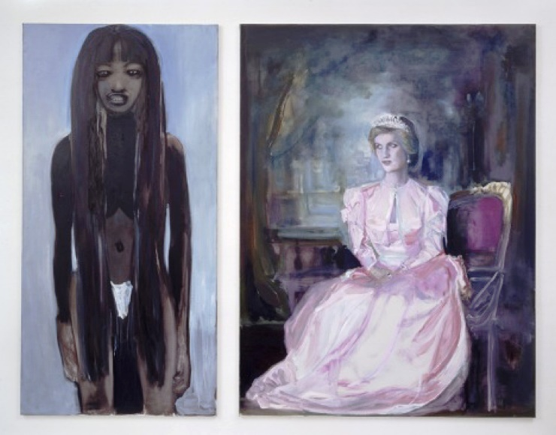
A Picture Dialogue
Marlene Dumas, “Great Britain” (1995–1997)
Look at the picture and talk to your partner about your first impressions.
  Who are the women in the picture?
  What do they look like?
  How do they feel?
Take notes on the public role of Lady Diana and Naomi Campbell in Great Britain in the 1990s.
Imagine that the two women meet between 1995 and 1997. What would they say? Take notes for your character.
Act out the dialogue.
Discuss the title of the painting.
Discuss Marlene Dumas’ statement:
“I don’t paint people, I paint images”.

Slide 3
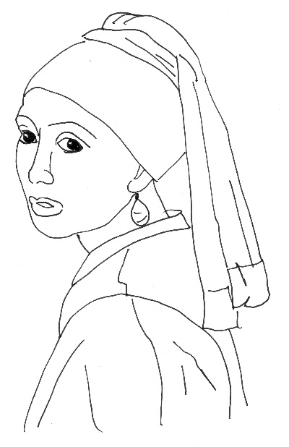
Girl with a Pearl Earring – Fact Sheet
Sketch
Artist (1632–1675)
Jan Vermeer
Title
Girl with a Pearl Earring
Date
1664-1666
Material
Oil painting
Art movement
Dutch Realism
What is in the painting?
The painting shows the head of a young girl or woman who is looking over her shoulder at the viewer. She is wearing a blue turban and a large, tear-shaped pearl earring that catches the viewer’s eye. Because of the mysterious way she looks at us, she has been nicknamed the “Mona Lisa of the North”.
What does the painting
mean for art history?
A remarkable feature of the painting is that Vermeer used no sketches to prepare the shape of the girl’s head. This points to the use of a “camera obscura”: a wooden box that is the precursor of today‘s camera.
What does the painting
mean to you?
I think that the girl’s look is expressing different feelings at the same time. She seems shy, perhaps because of the attention that she is given. But she also seems very confident, perhaps for the same reason. To me, this is part of the painting’s mystery.

Slide 4
Your Artwork – Fact Sheet
Sketch
Artist (… – …)
Title
Date
Material
Art movement
What is in the painting?
What does the painting
mean for art history?
What does the painting
mean to you?

Slide 5
Museum Label
Andy Warhol (b. 1928 – d. 1987)
Campbell’s Soup I: Onion, 1968
Silkscreen on paper
The painting shows a regular can of soup as produced and sold by Campbell, a U.S. soup company. Here, Warhol uses an ordinary object from everyday life, which could be found in any U.S. supermarket. However, the artist moves the simple soup can onto the canvas and into the museum. By doing so, he cleverly violates the tradition that artworks should have a religious, moral, or educational value. For today’s visitors, who are used to similar images from advertising, the irritating effect of the original painting might be lost. But they can still imagine how the artwork may have frustrated, but also fascinated, museum-goers of the 1950/60s.

