Slide 1

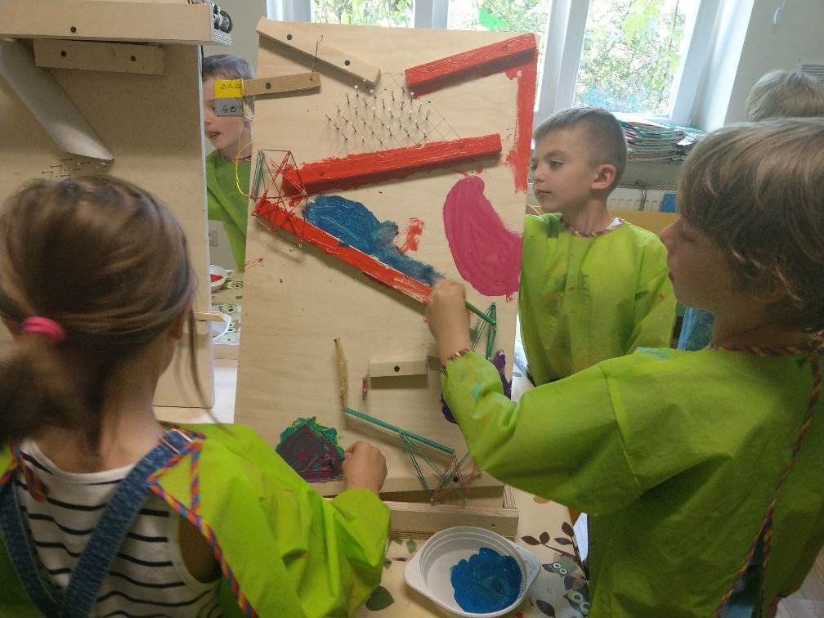


CHAIN EXPERIMENT IN PRE-SCHOOL
From October 2018 EU Kids Kindergarten in Sopot, Poland is taking part in an international educational project Erasmus + entitled “Chain Experiment in Pre-School”
The aim of the Project is to stimulate children’s creativity, interest in experiments and technology as well as connecting generations.

Slide 2
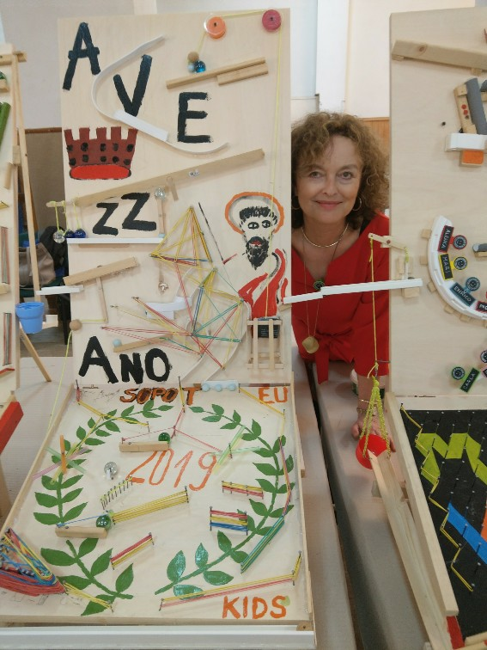
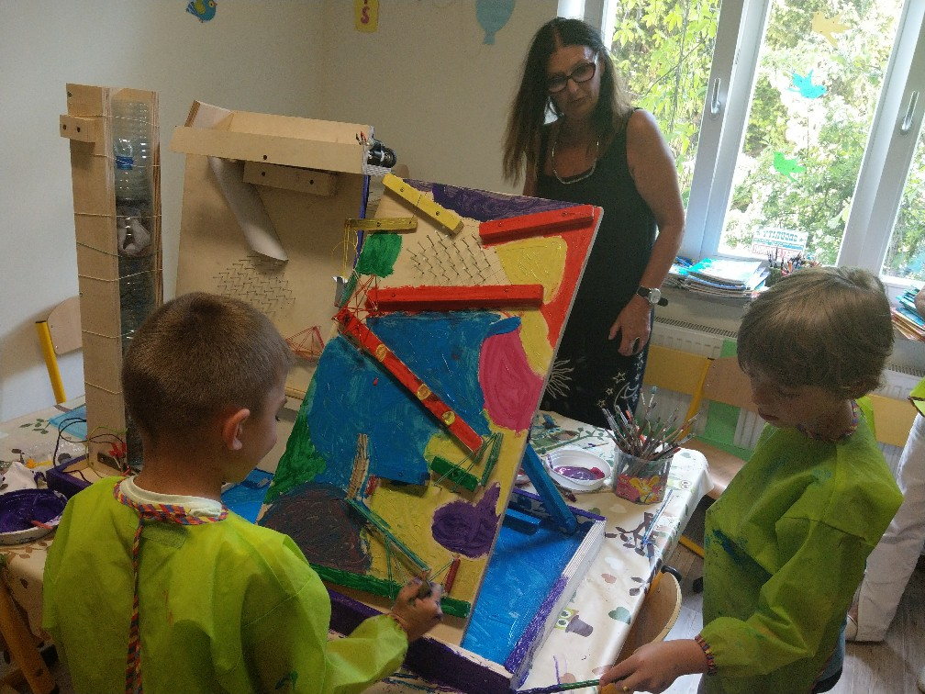


CHAIN EXPERIMENT IN PRE-SCHOOL
The partners of the Project are educational institutions from Slovenia (Coordinator), Croatia, Italy and Poland represented by EU Kids.
With the help of adults (grandparents, parents, teachers) children build different constructions for playing but they also learn the basic laws of physics and technology.

Slide 3
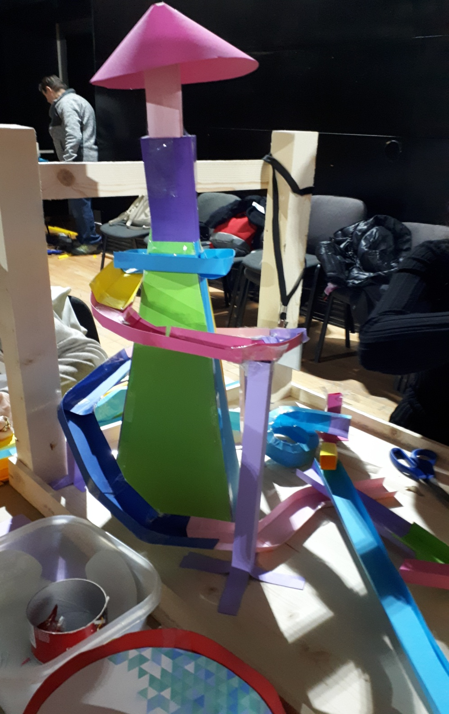
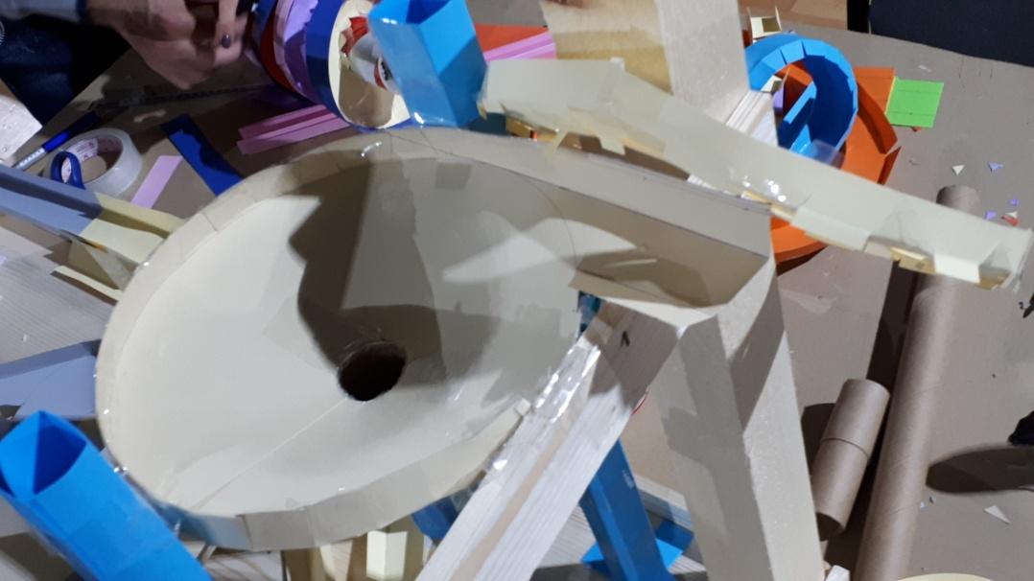

Constructing a downhill track from different elements of the chain.

Slide 4
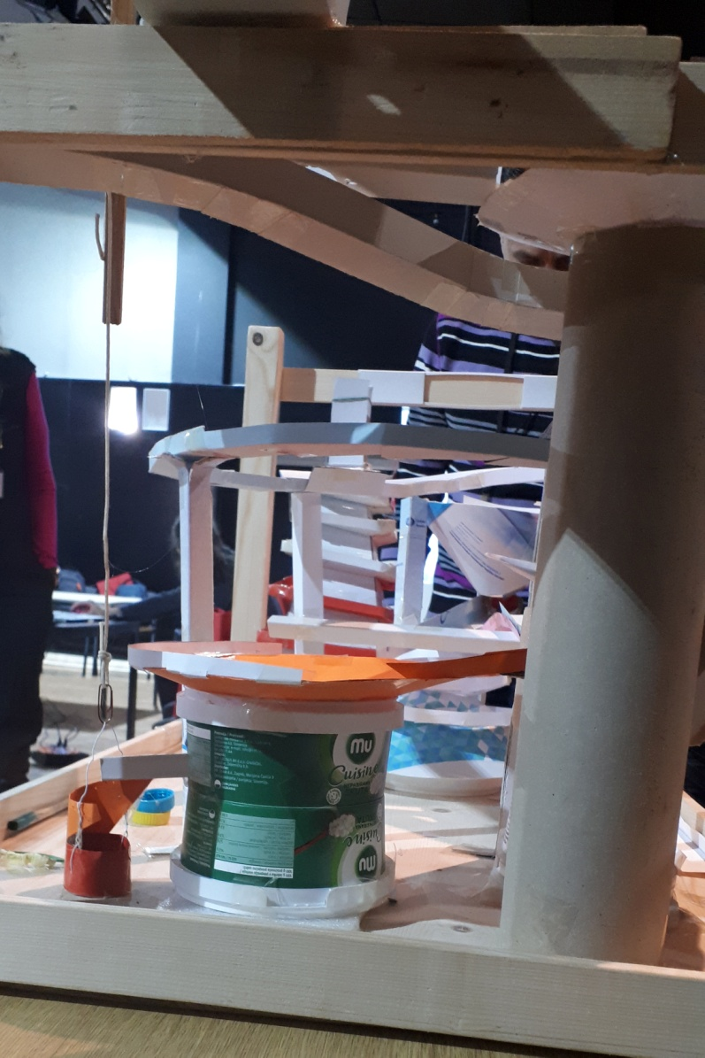
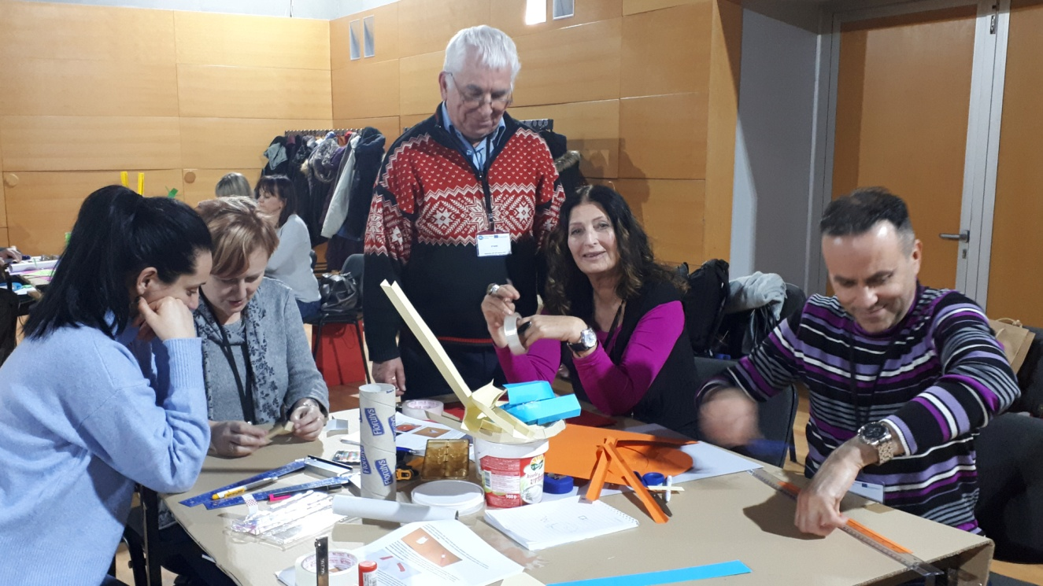
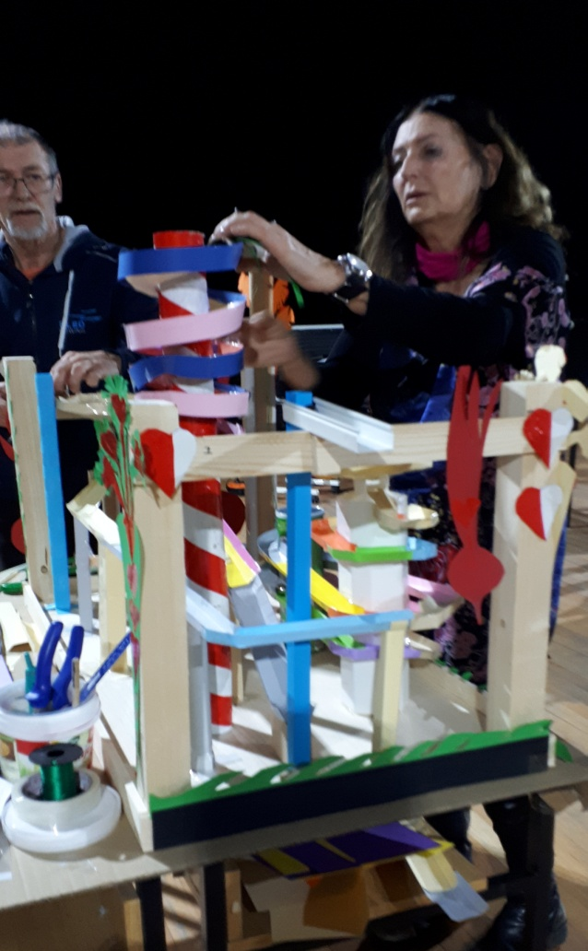
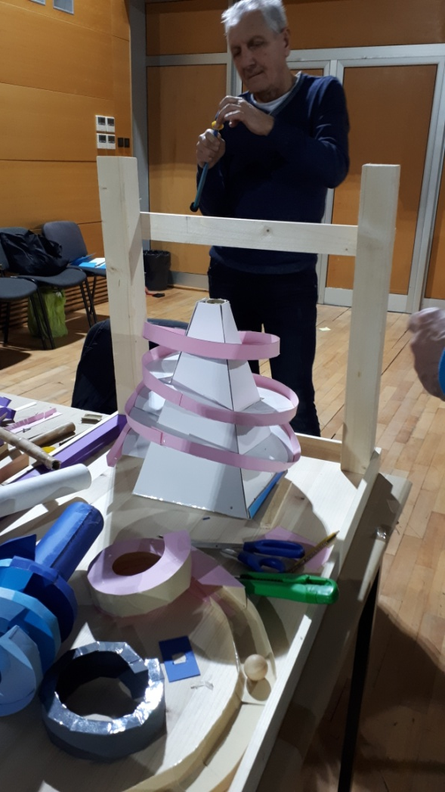
The team is building a track starting with a concept and plan then prepare elements which form a track best for the downhill slide of a metal ball.

Slide 5
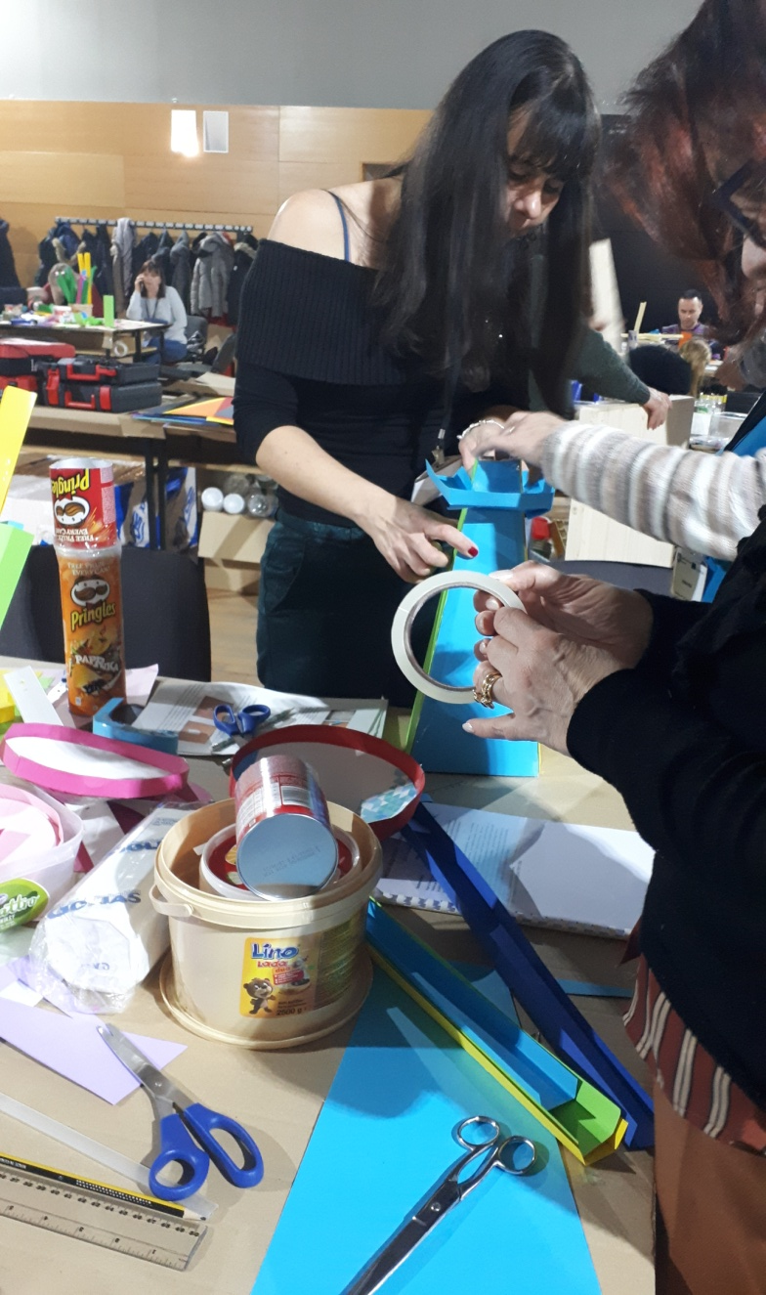
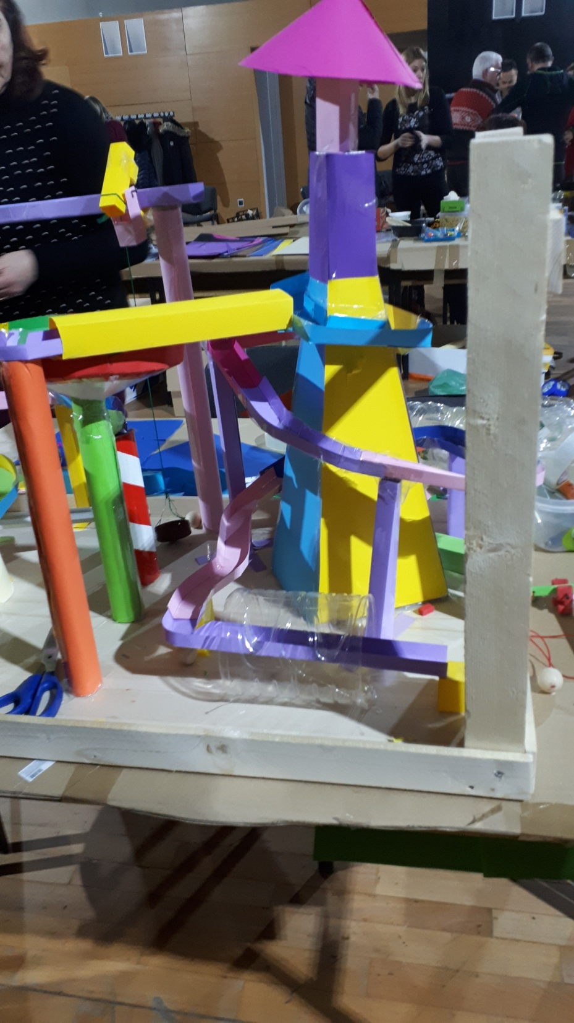
Paper is a very easily accessible and excellent material for making different constructions.

Slide 6
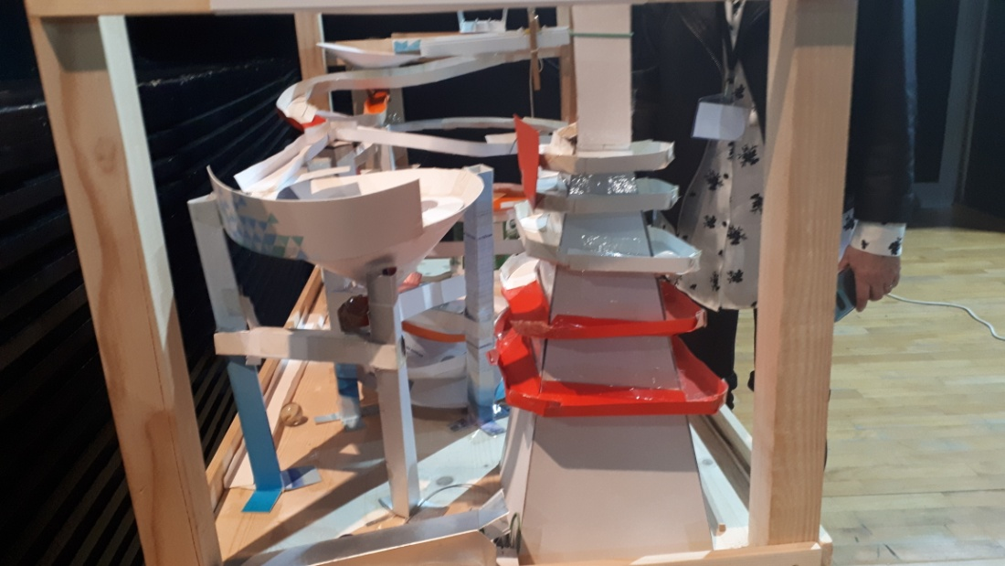
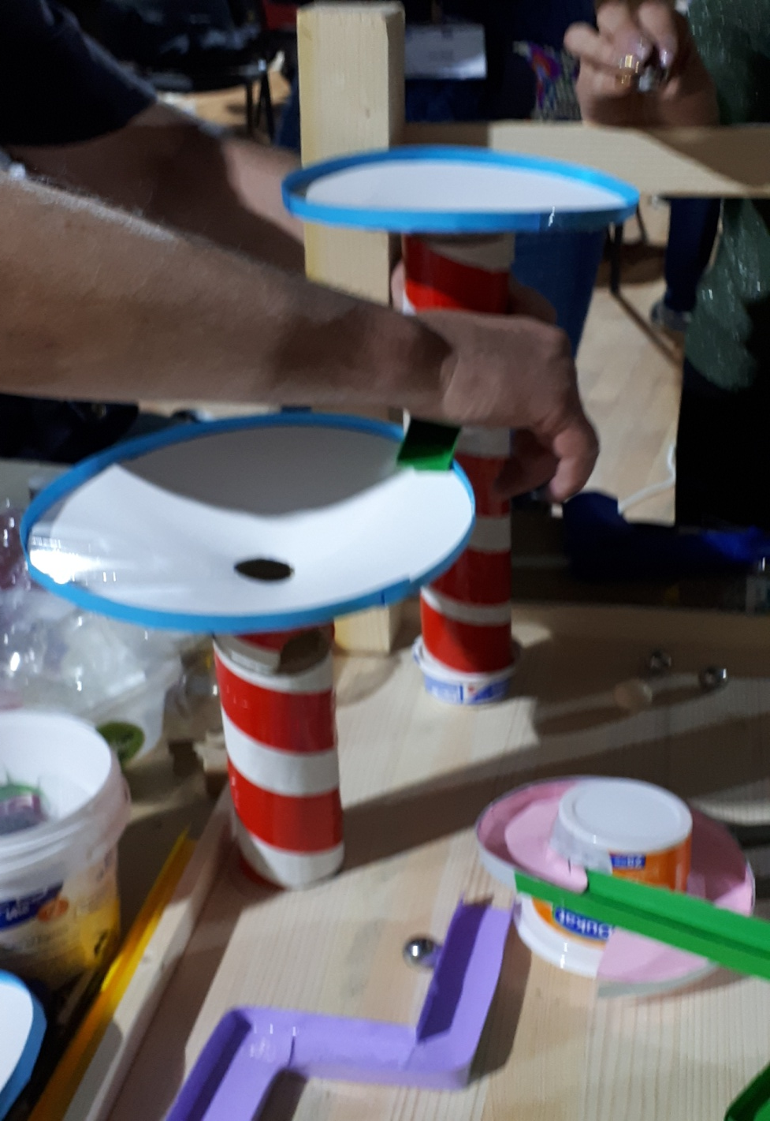

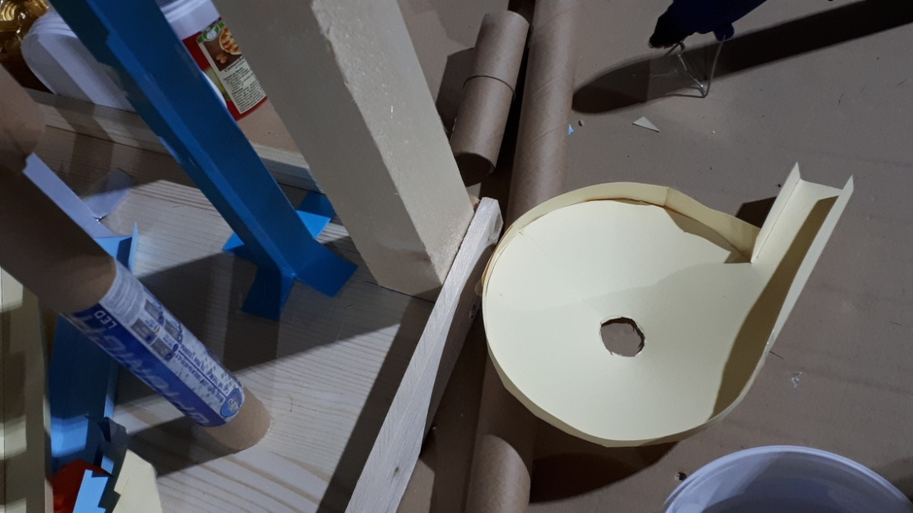
Recycled and waste paper can be used for building the chain experiment downhill tracks.

Slide 7
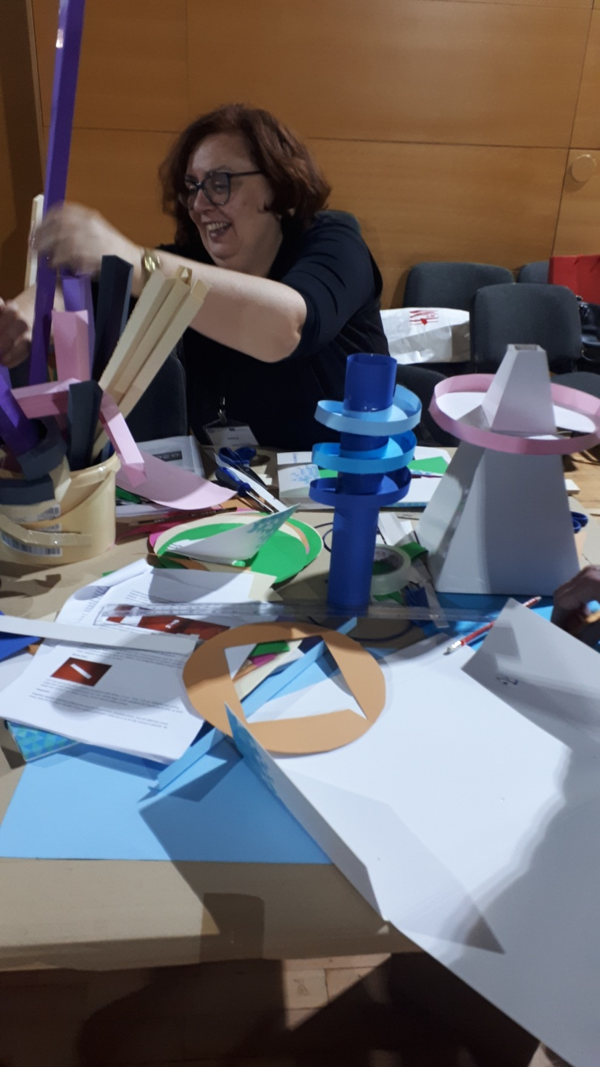
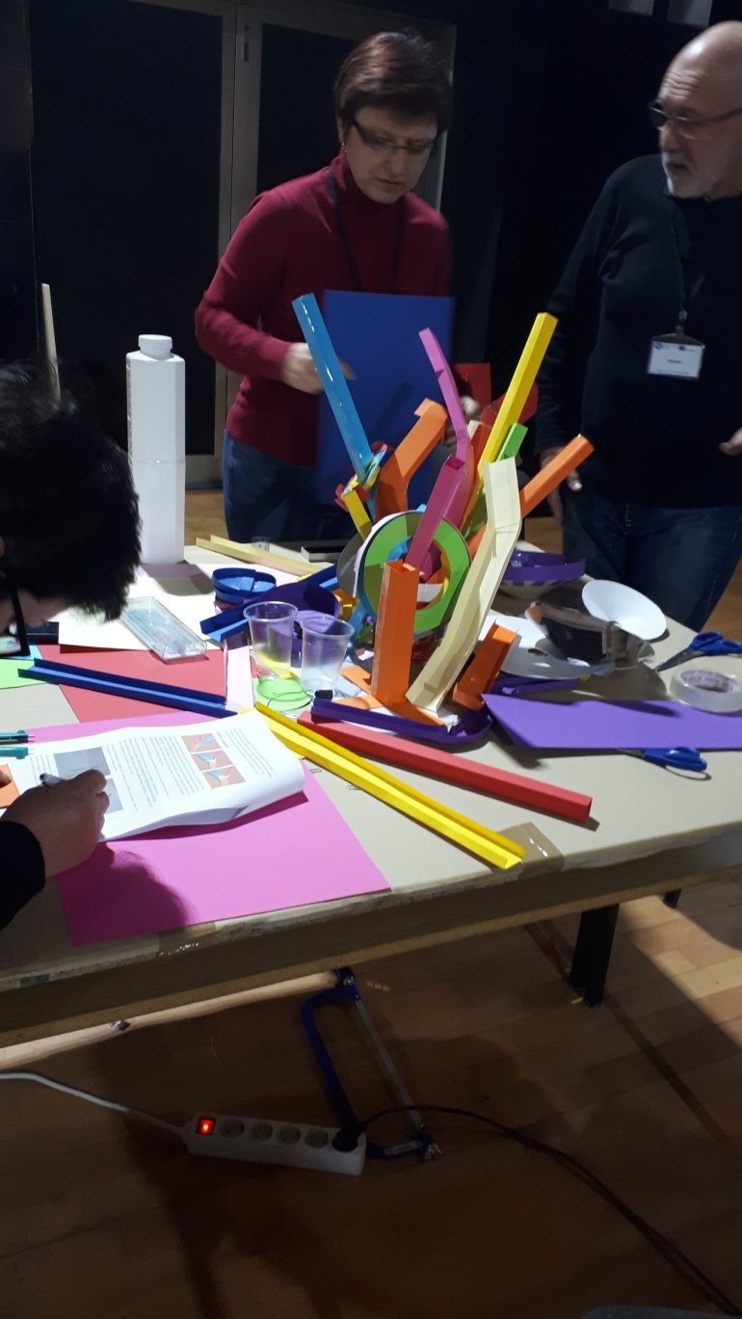

Constructions are made mainly with paper but plastic and wooden elements can be used to make the construction more durable.

Slide 8
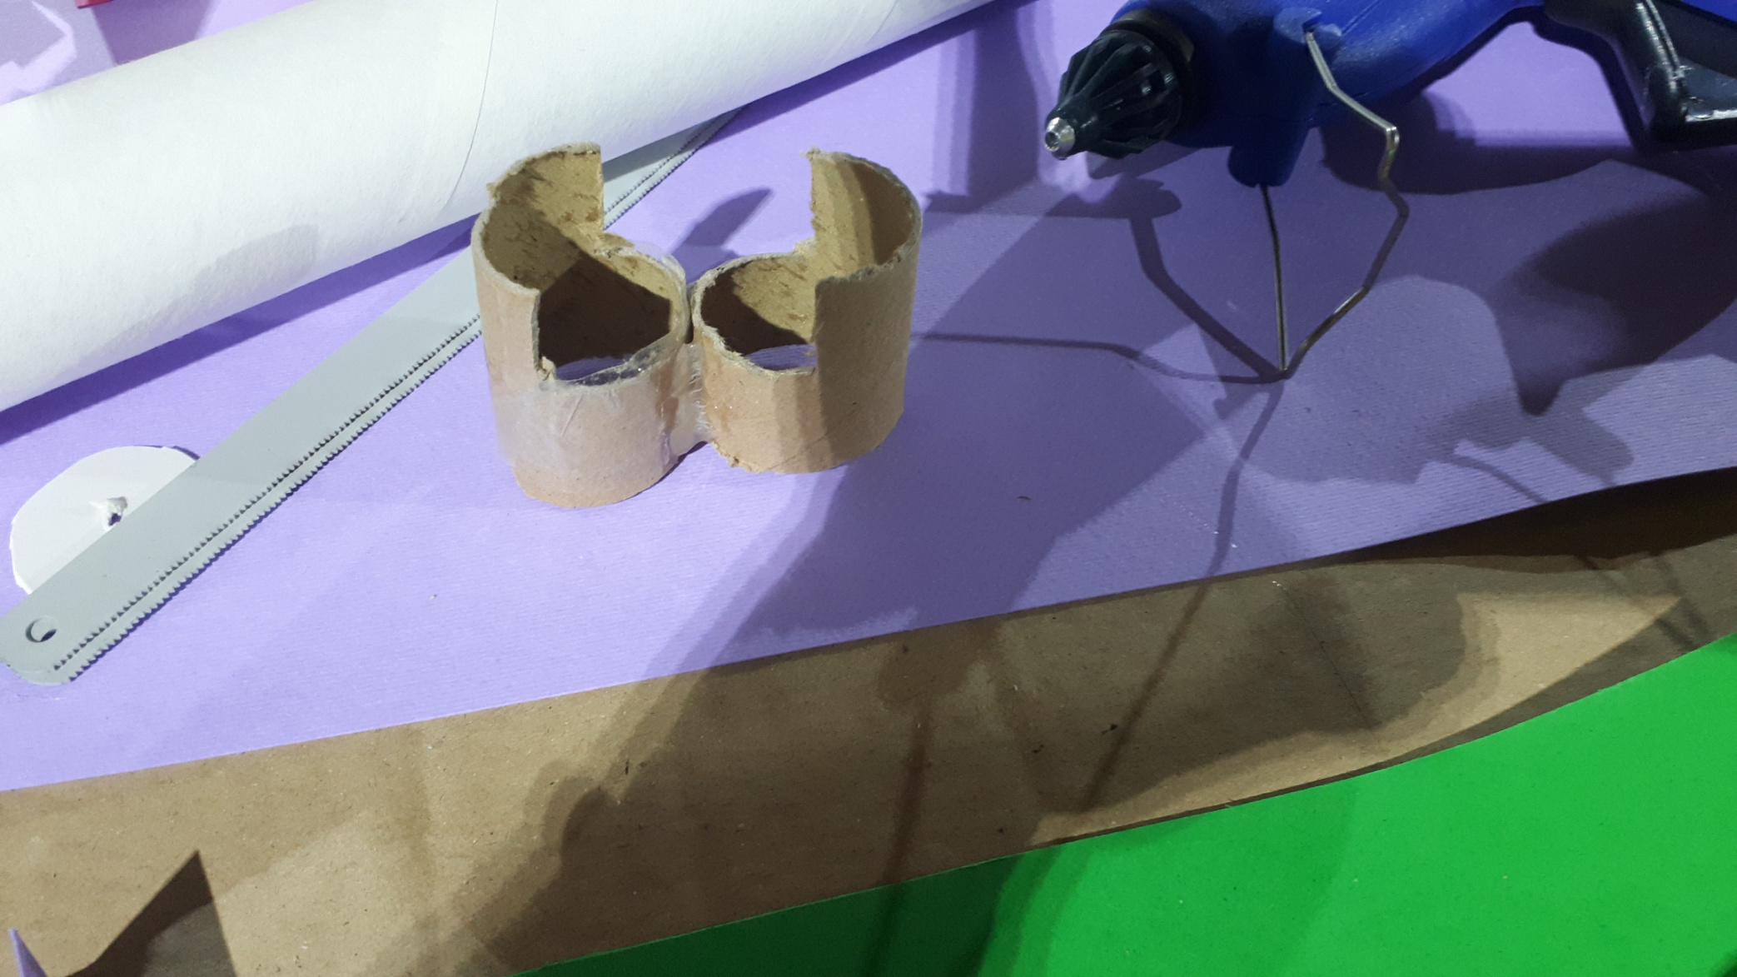
Different elements of the construction are glued together.

Slide 9
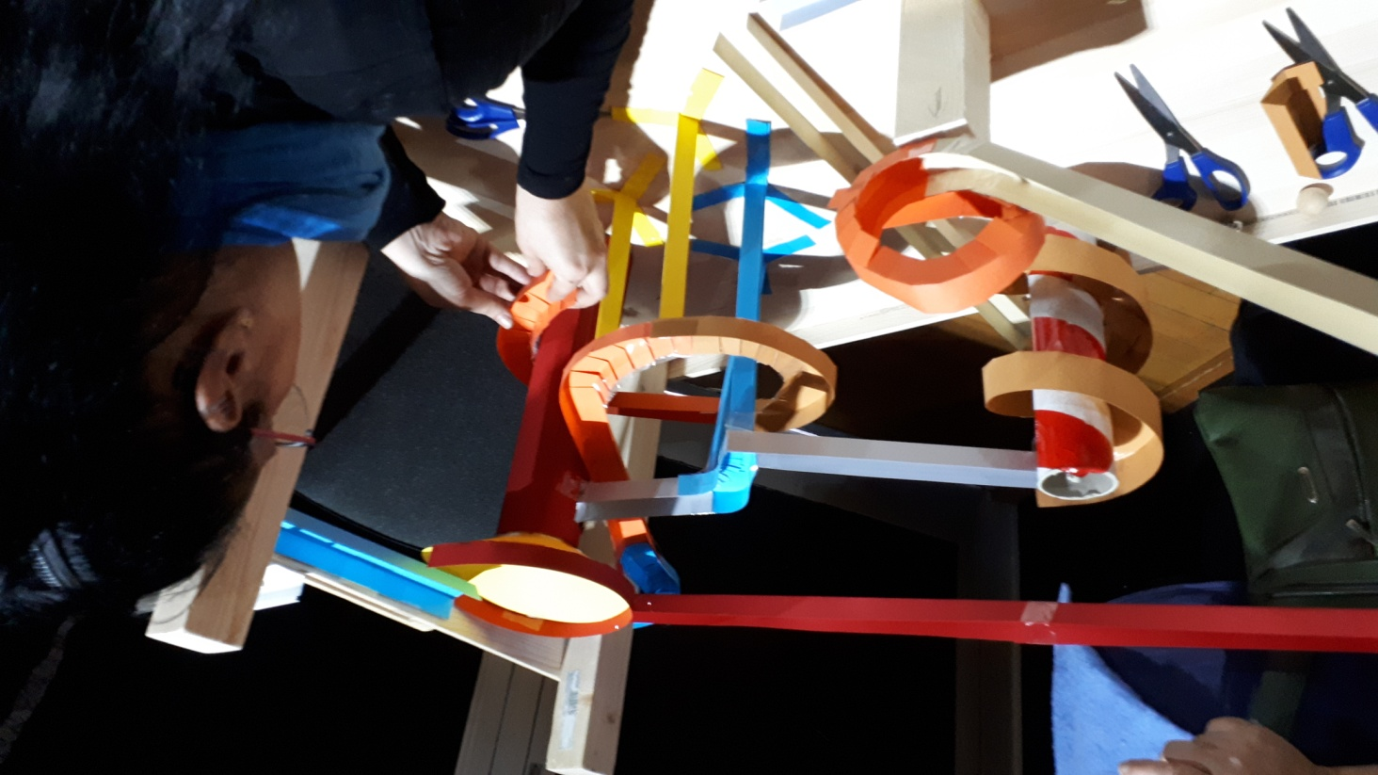

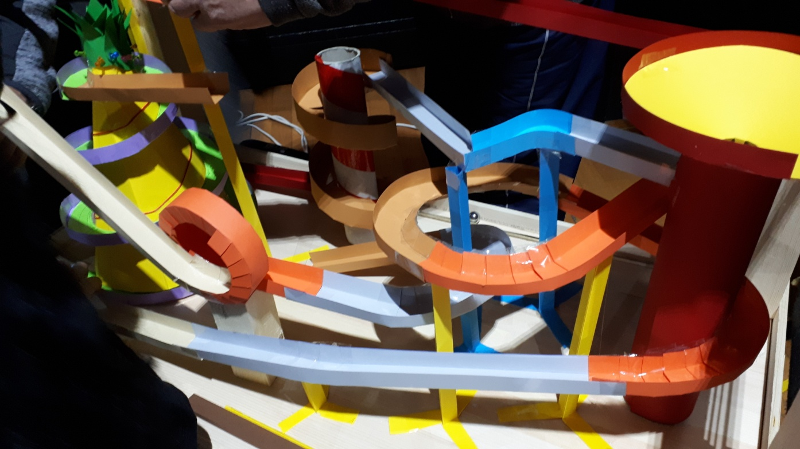
Paper and plastic waste are given new life.

Slide 10

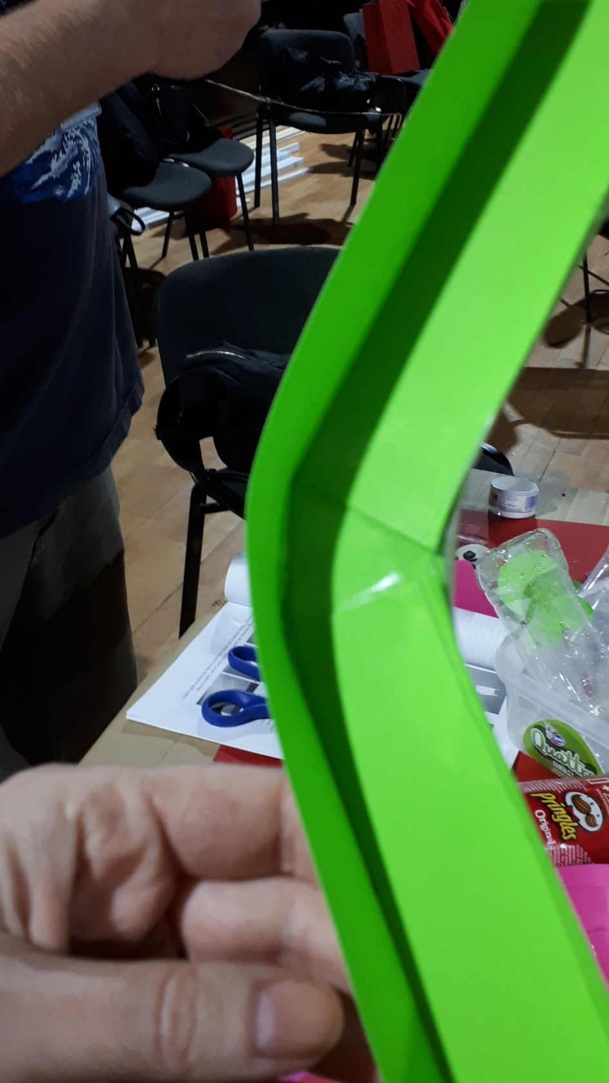

The elements of the downhill track have a different degree of difficulty.

Slide 11
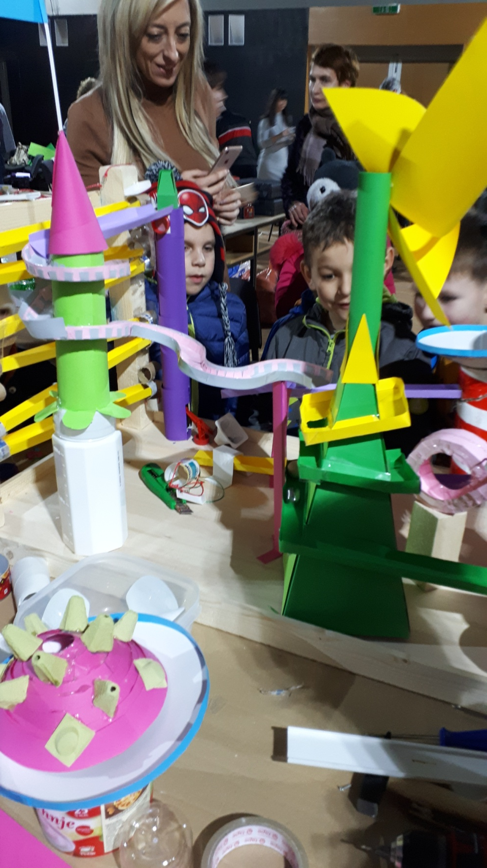
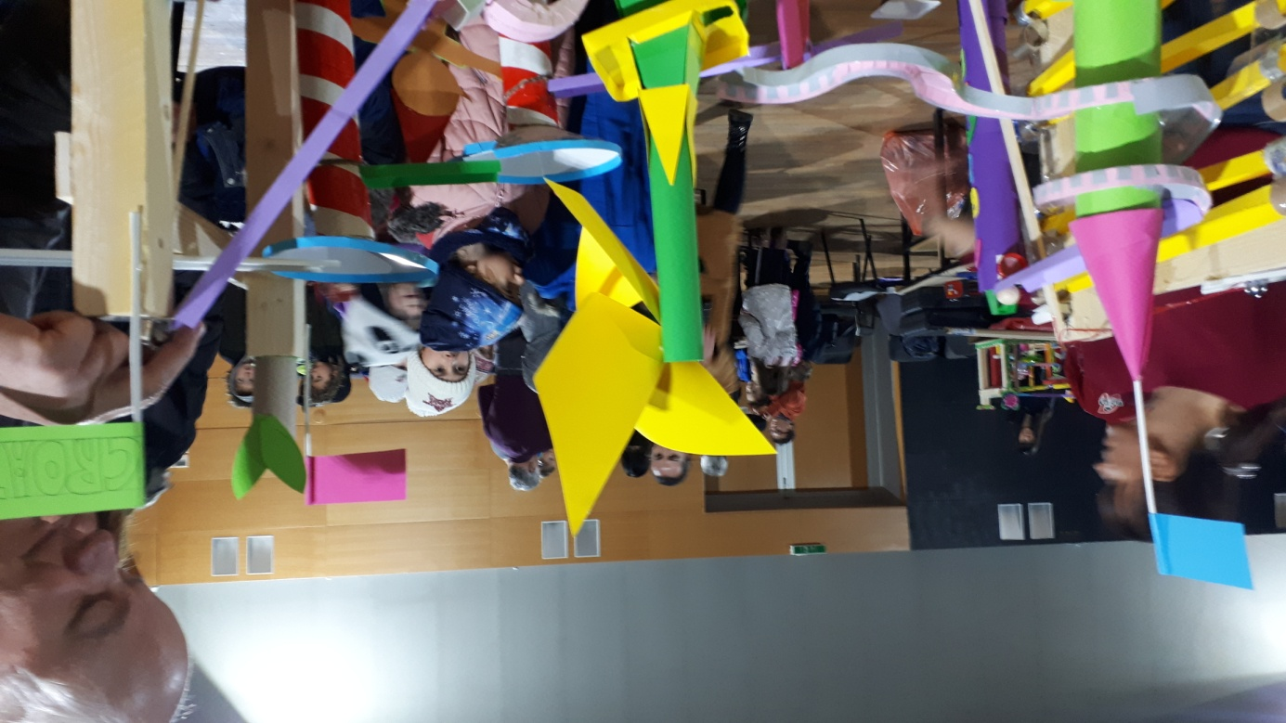
Children use their kindergarten creative experience.
Under the supervision of teachers they build new elements of the chain.

Slide 12

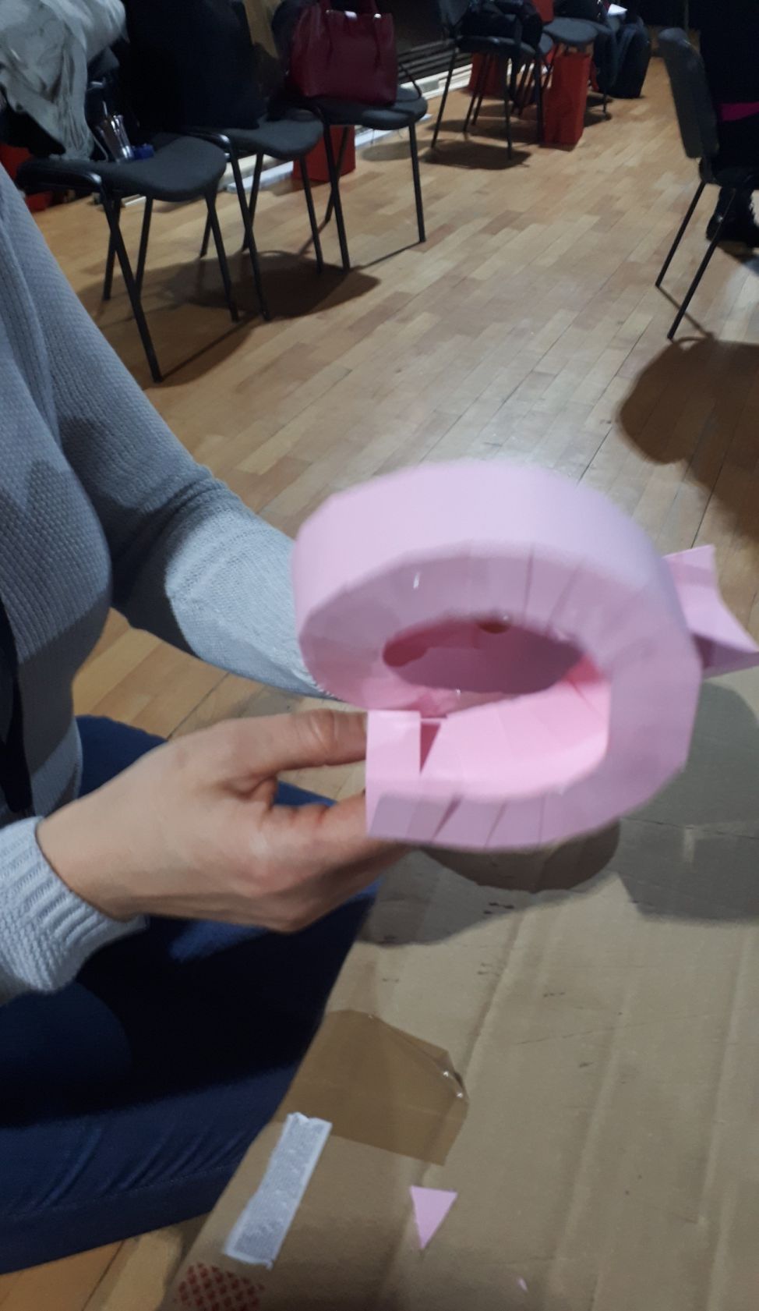
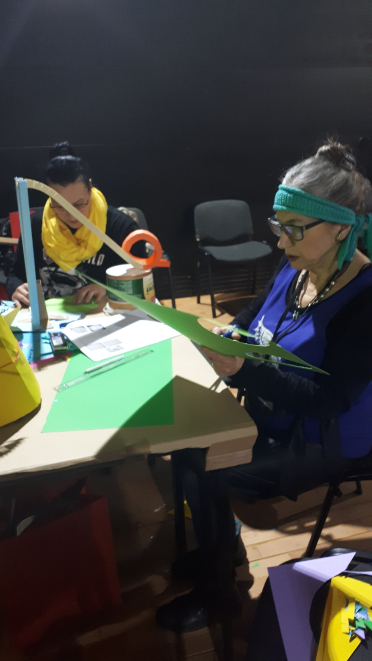
The elements are built according to the instructions.

Slide 13
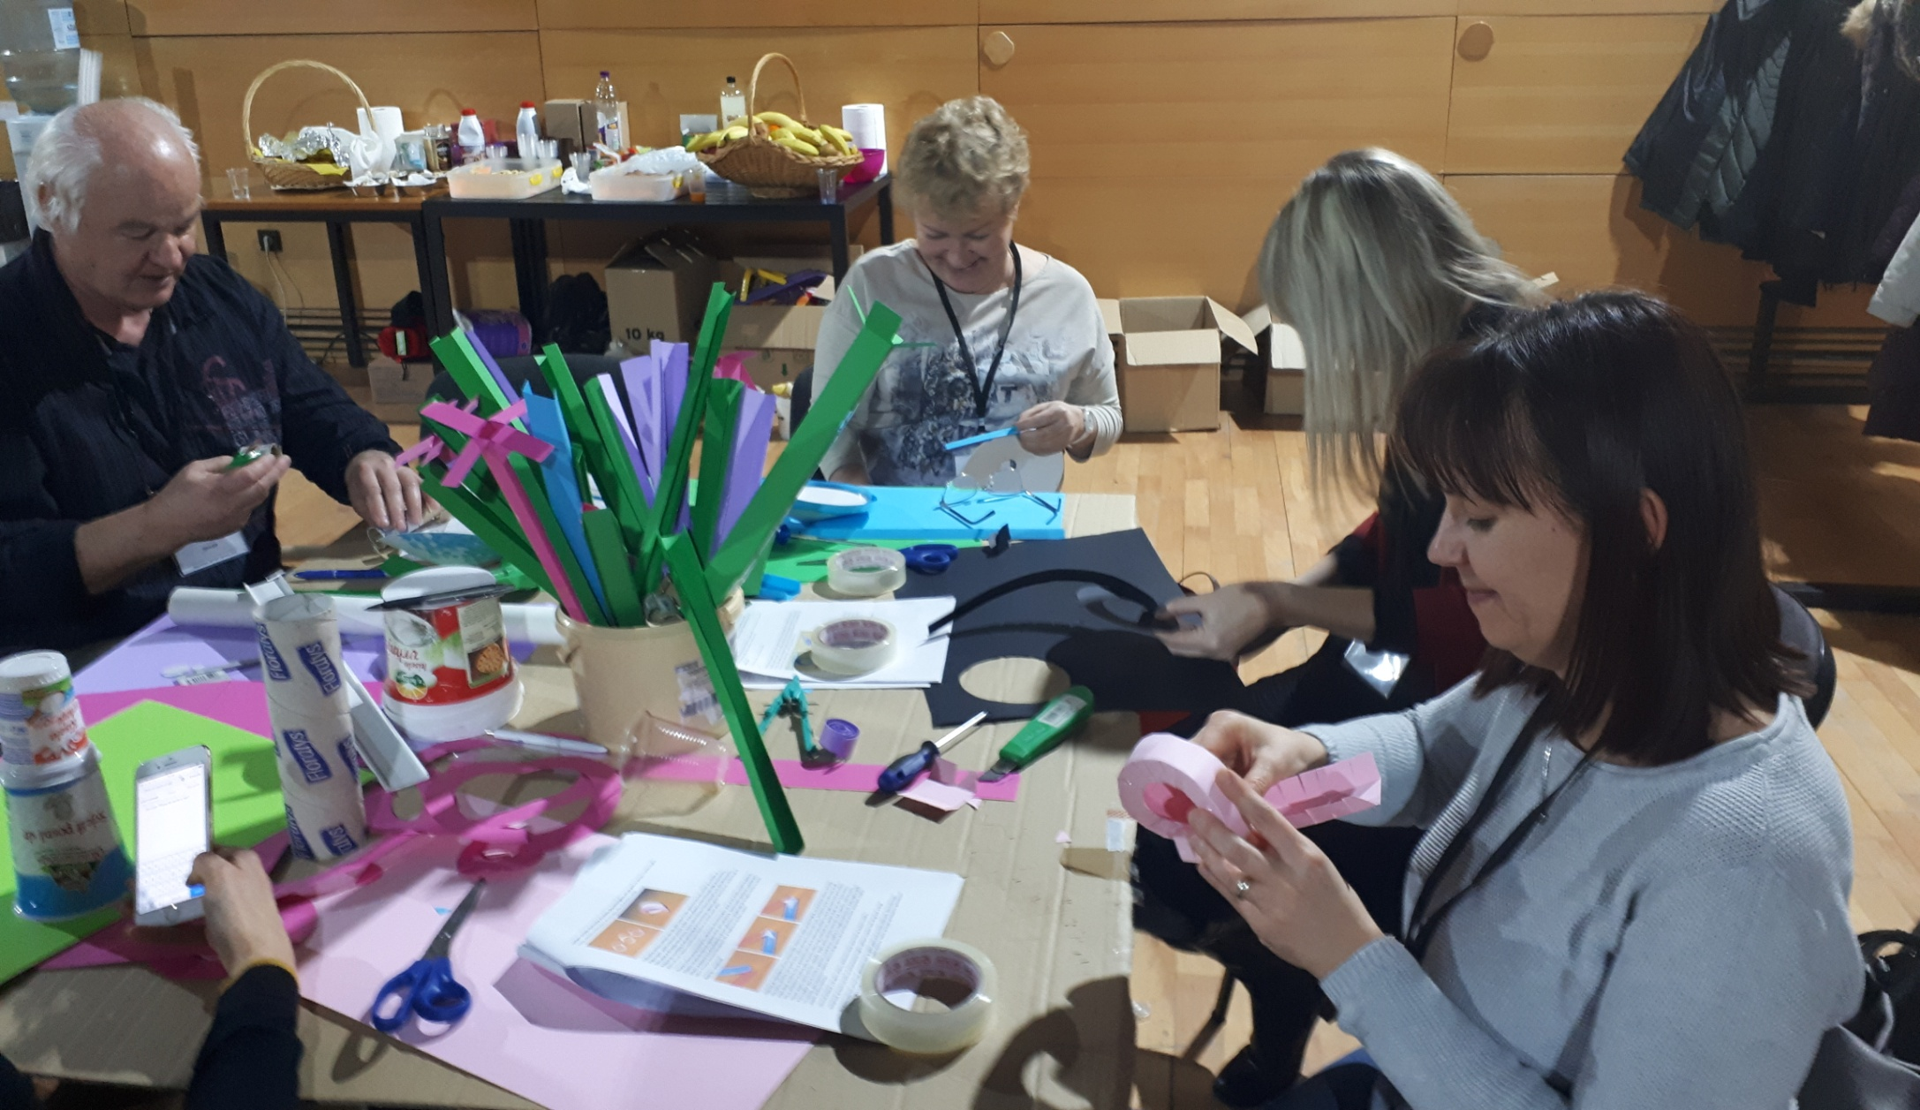

Mentors learn how to construct a track and then stimulate children’s ideas and creativity.

Slide 14

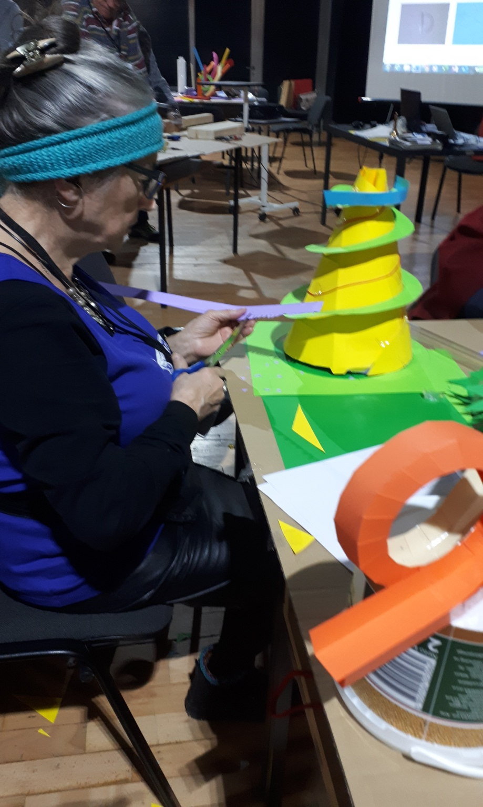

Elements of the construction are put within a wooden frame.

Slide 15
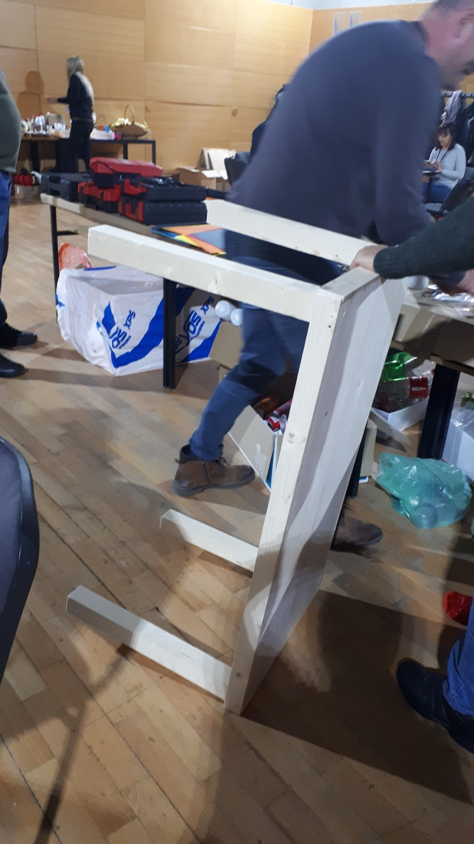
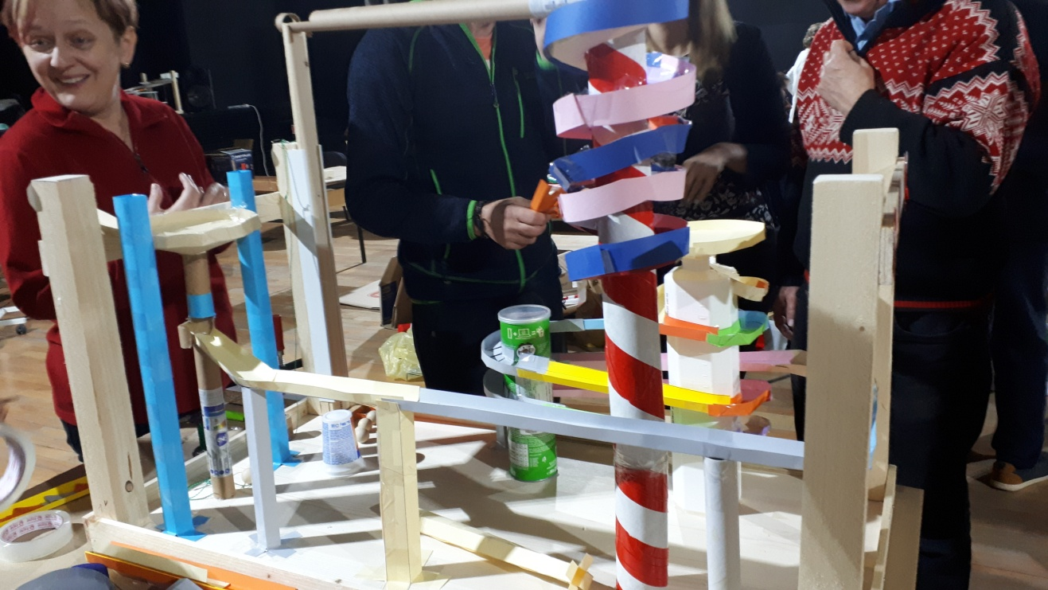
The wooden frame protects the paper construction.

Slide 16
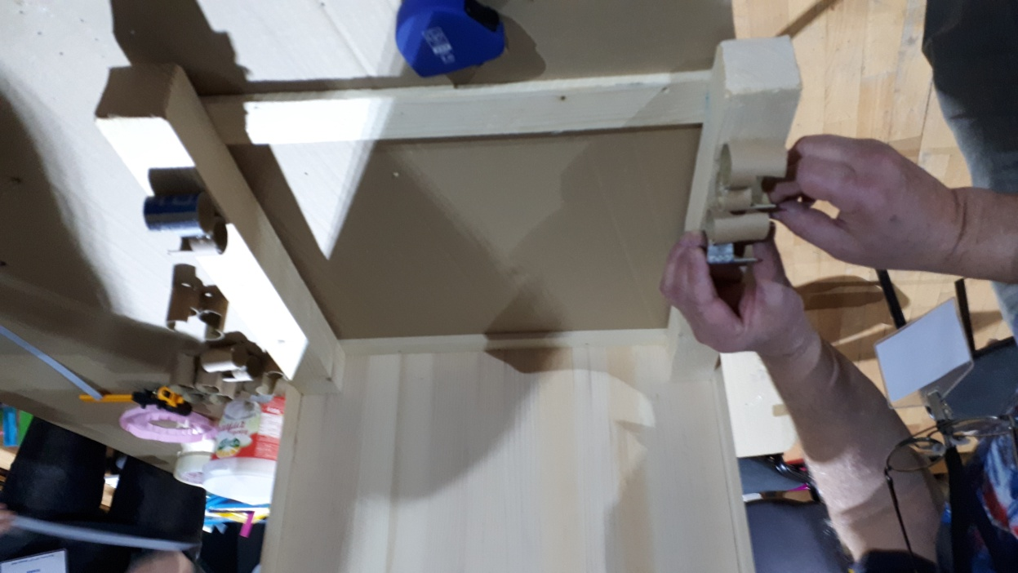

The wooden frame allows for easy transport of the construction.

Slide 17
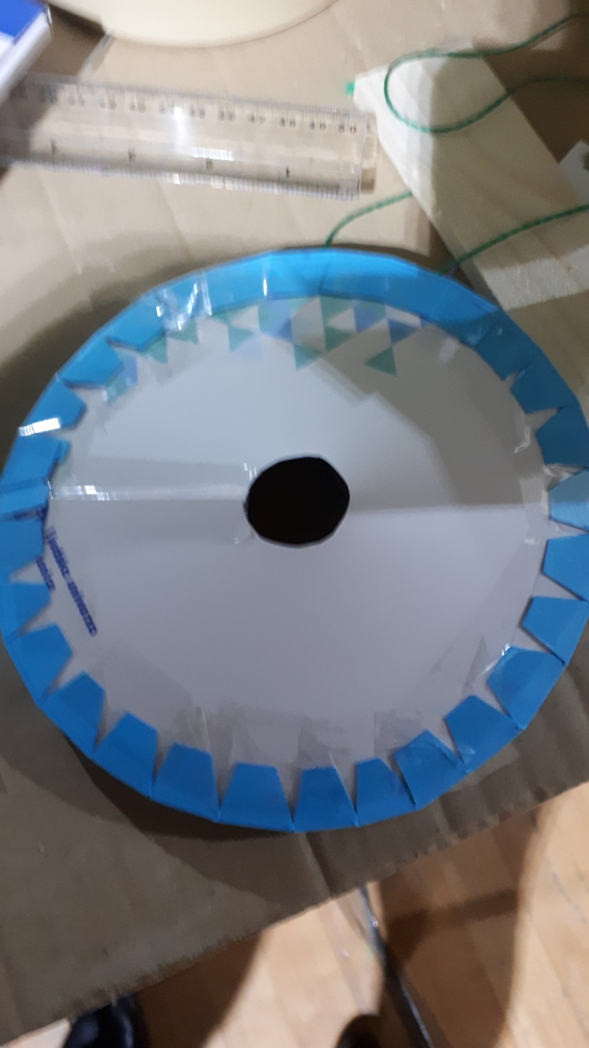
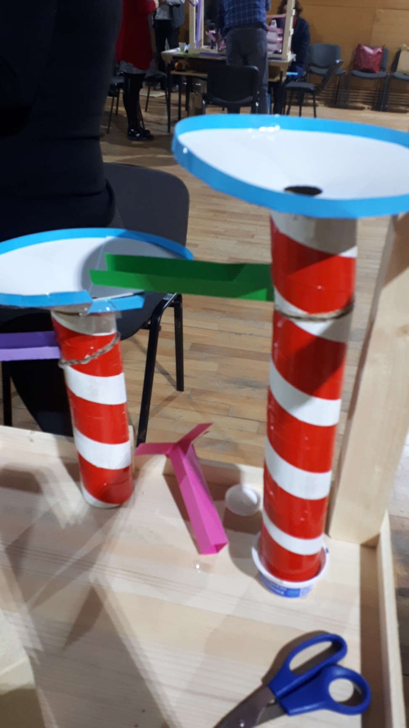

Slide 18
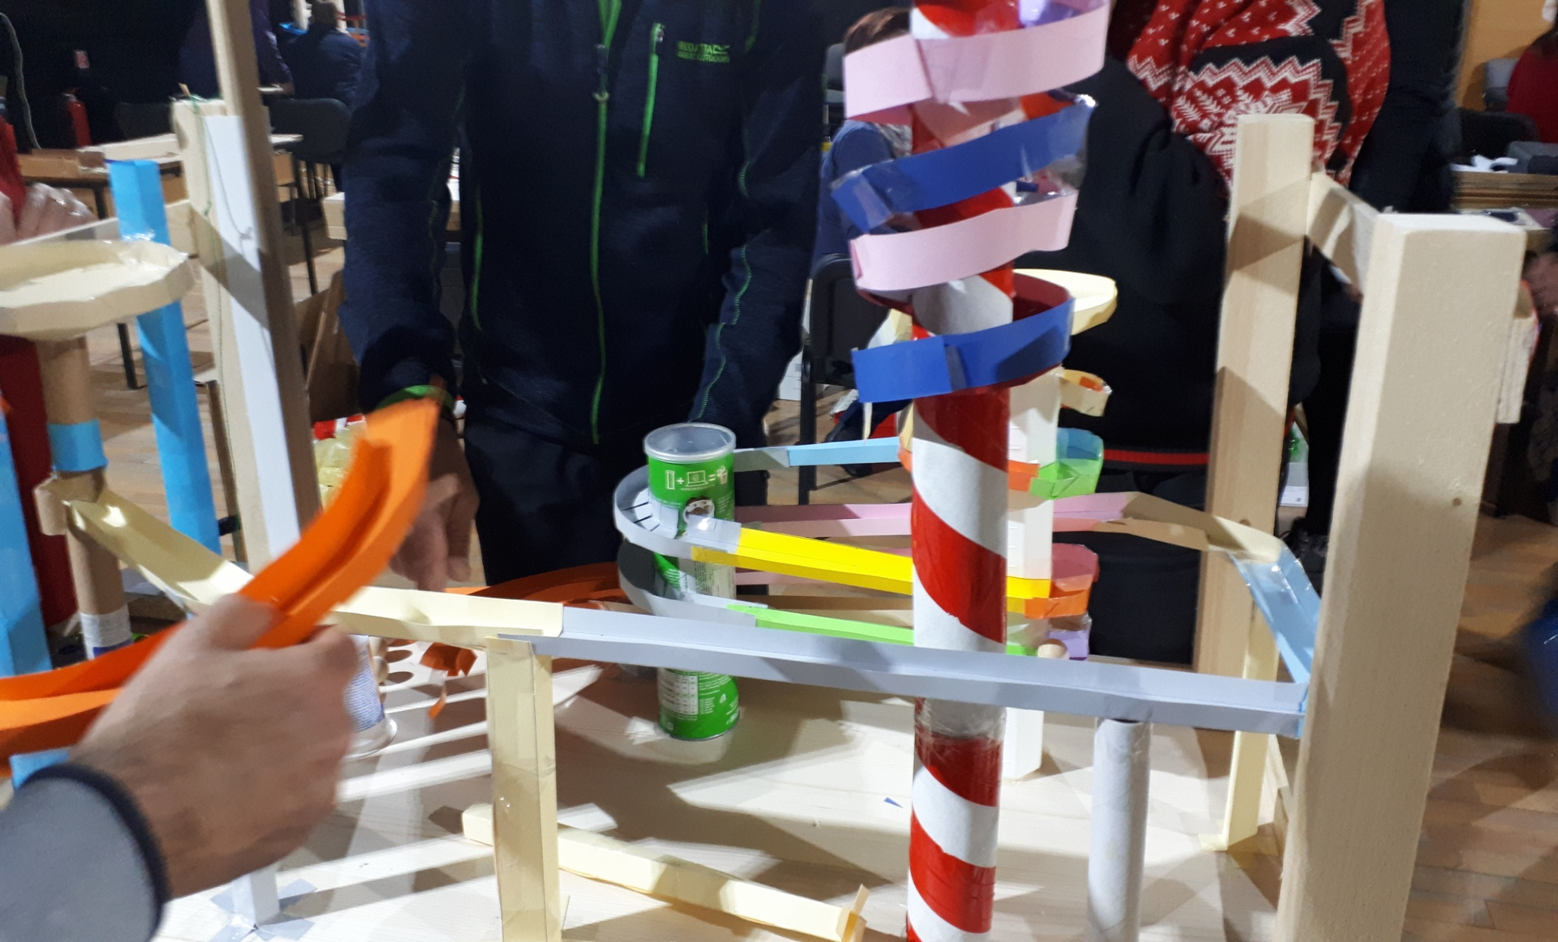
The spiral is made of single elements and can be very long.

Slide 19

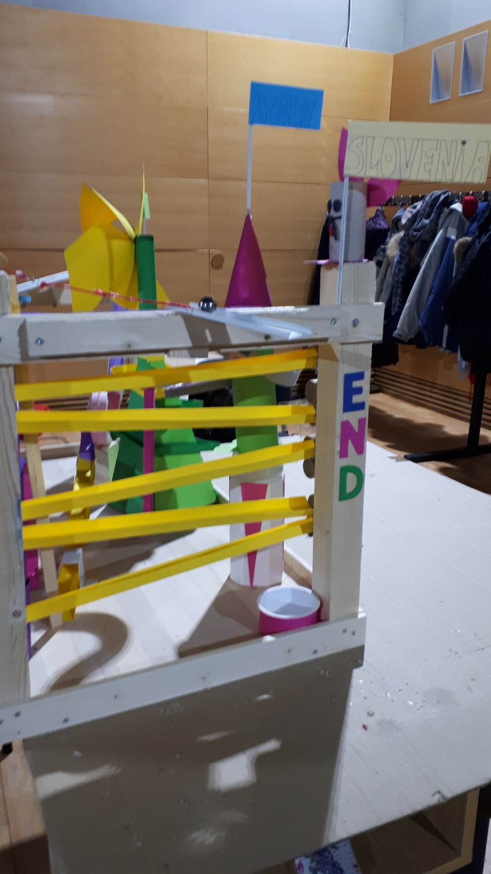

Slide 20
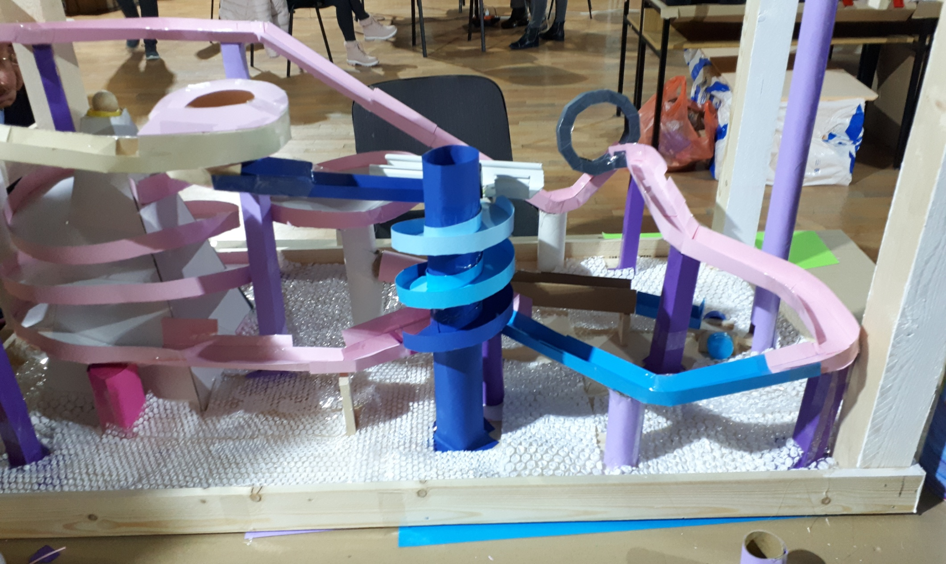
Another version of the downhill track.
Metal, wooden or glass balls go down the track.

Slide 21
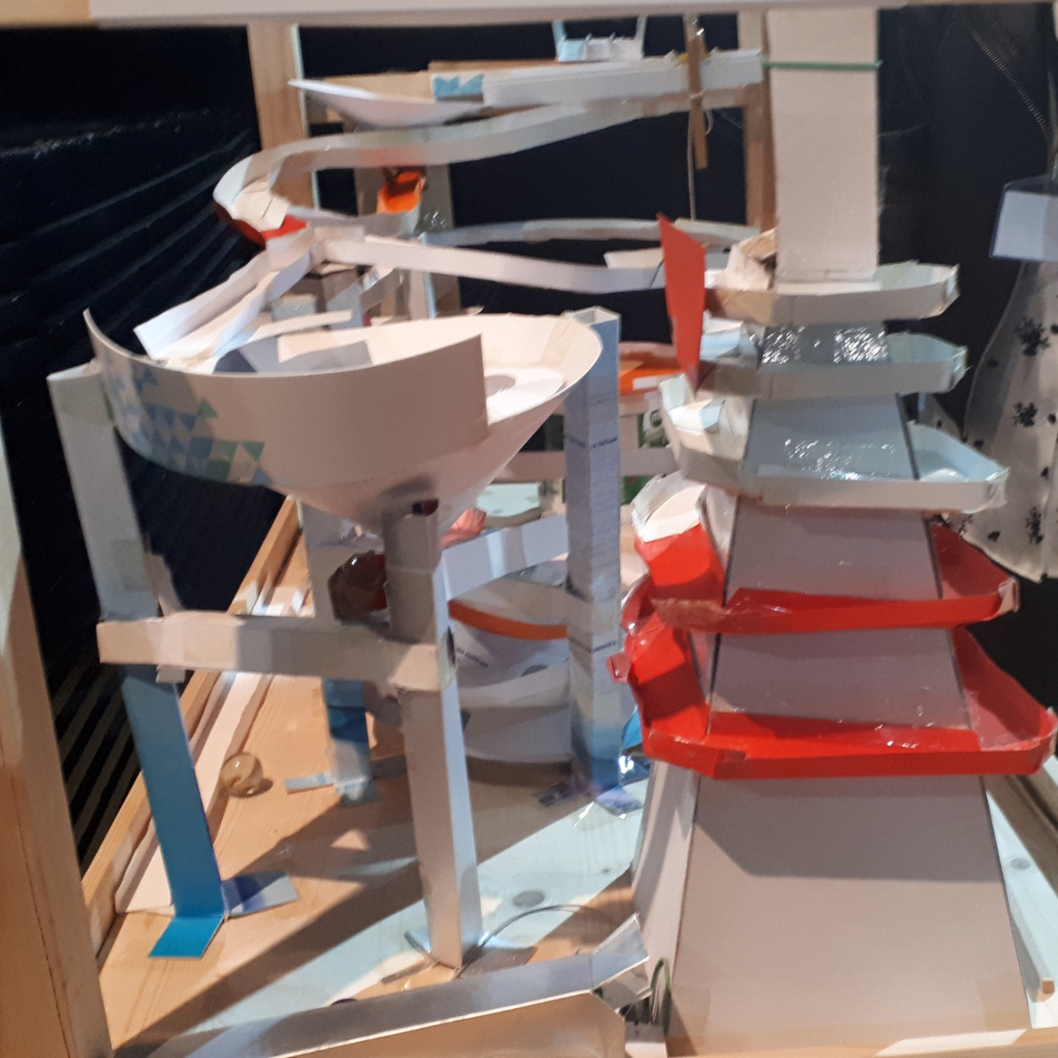
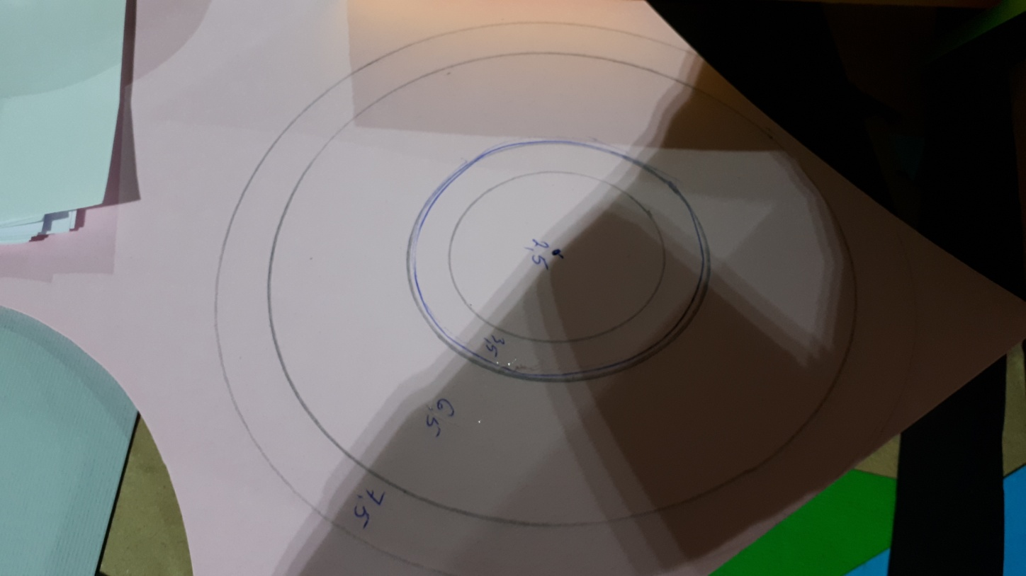
The project develops creativity, imagination, planning and group work.

Slide 22
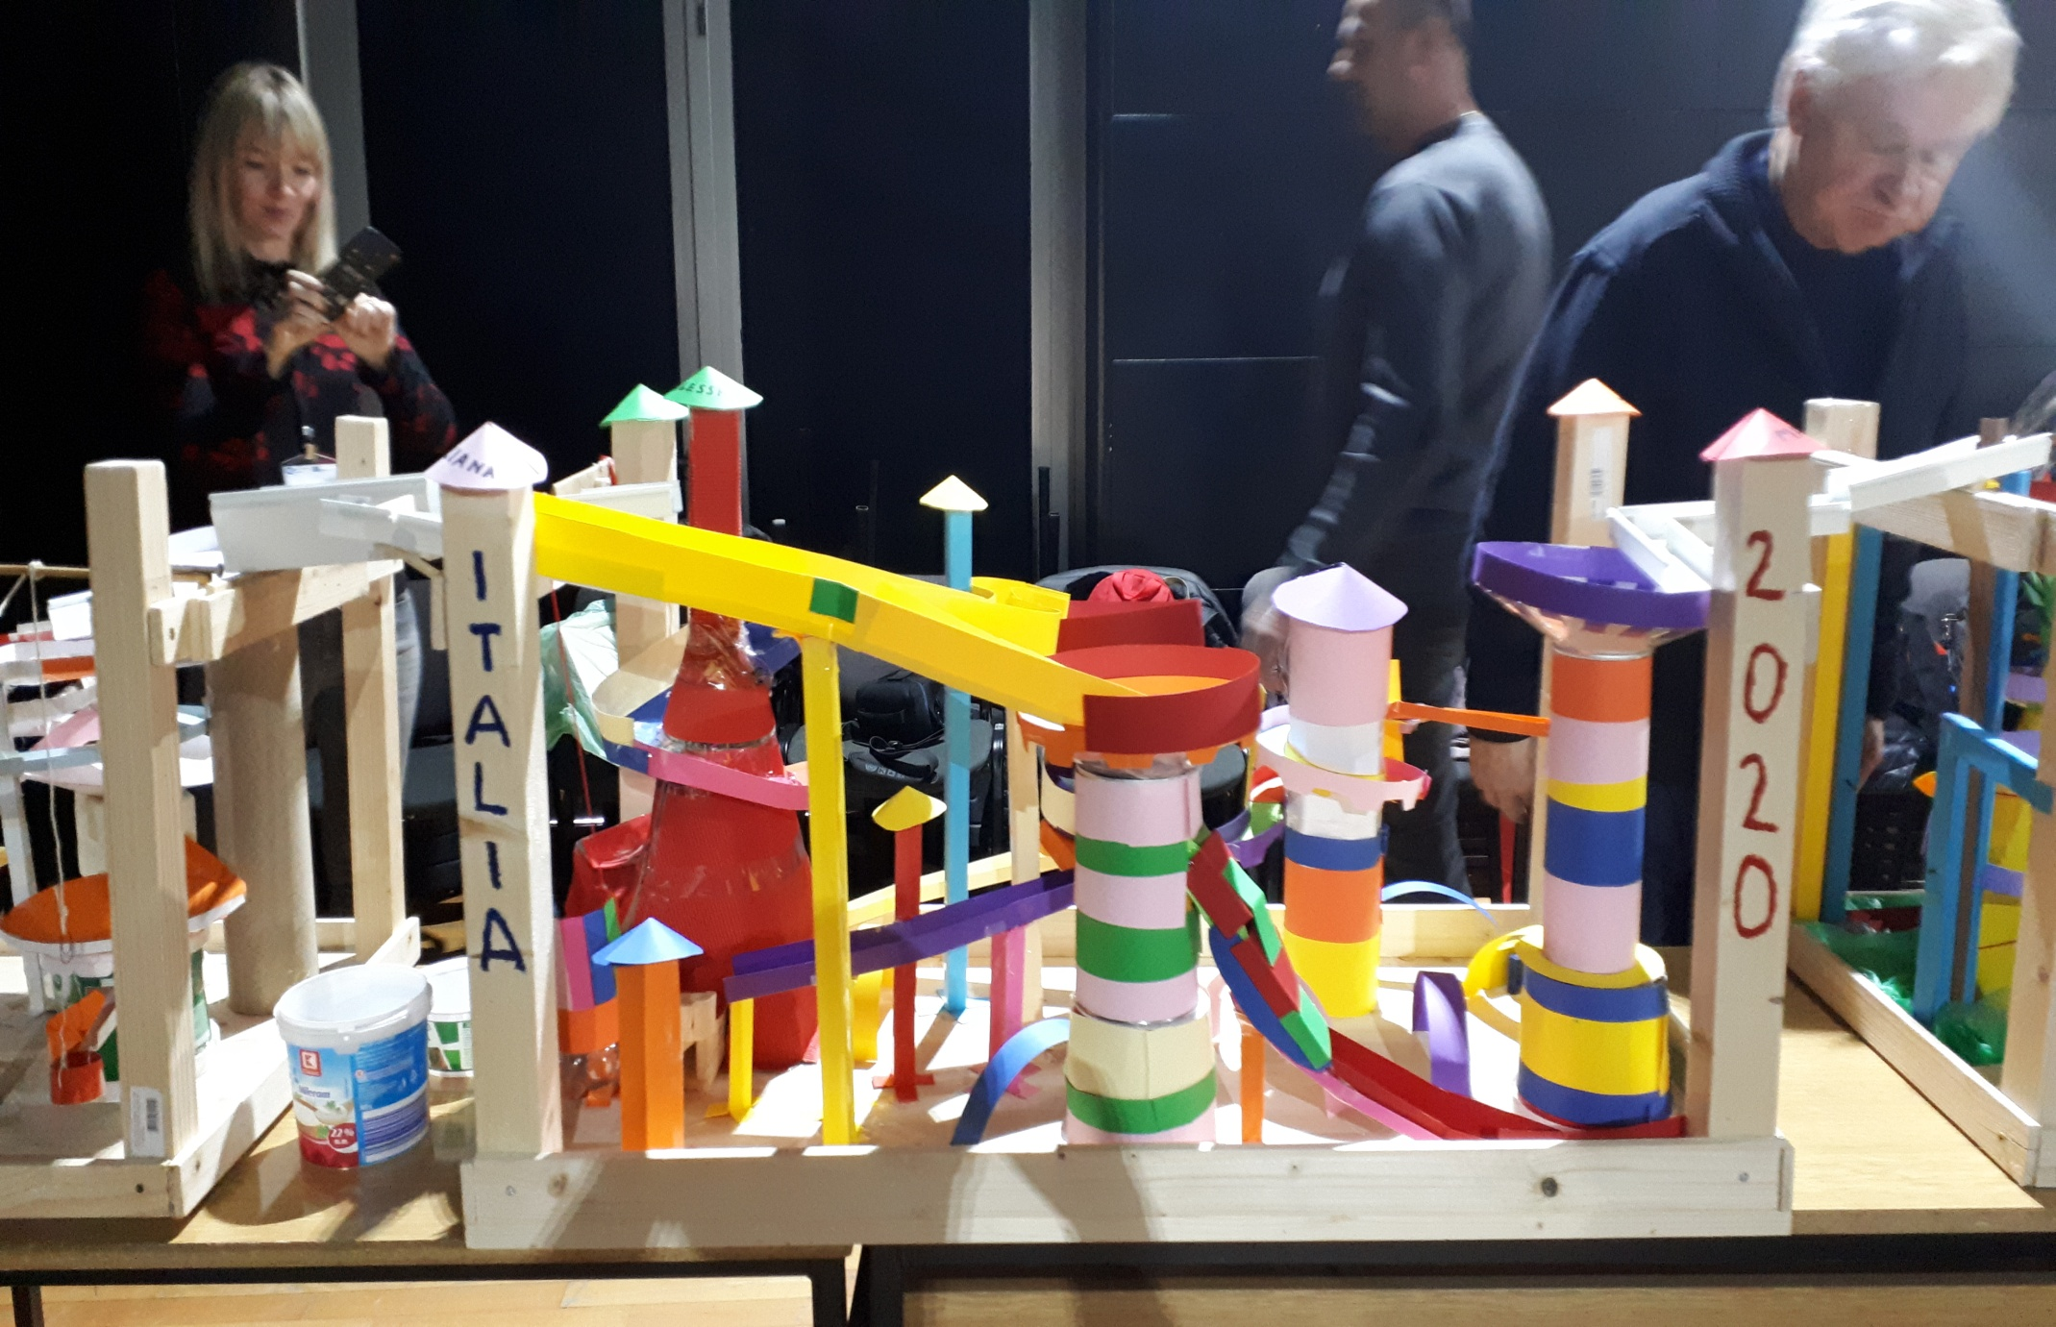
Another variant of the track.

Slide 23
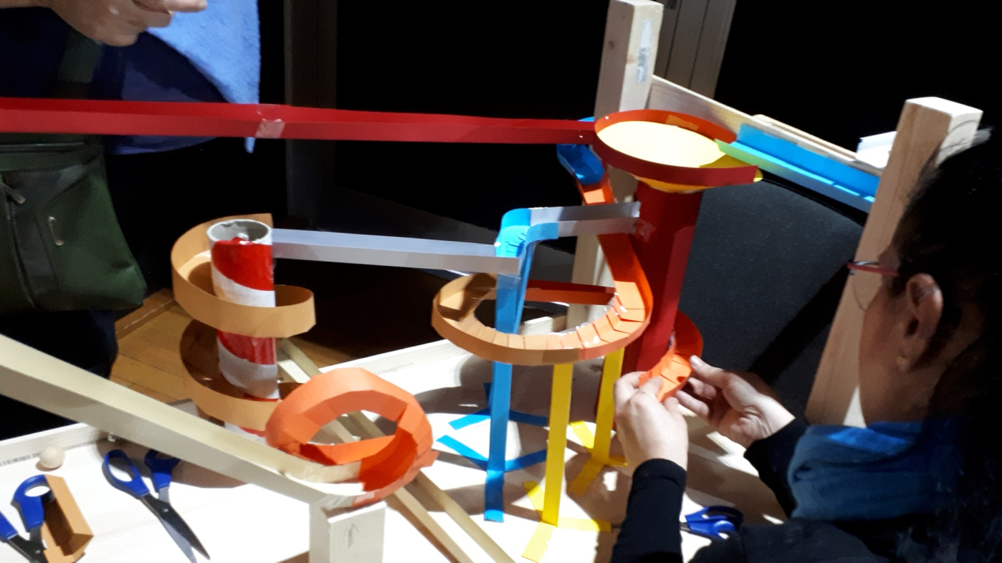
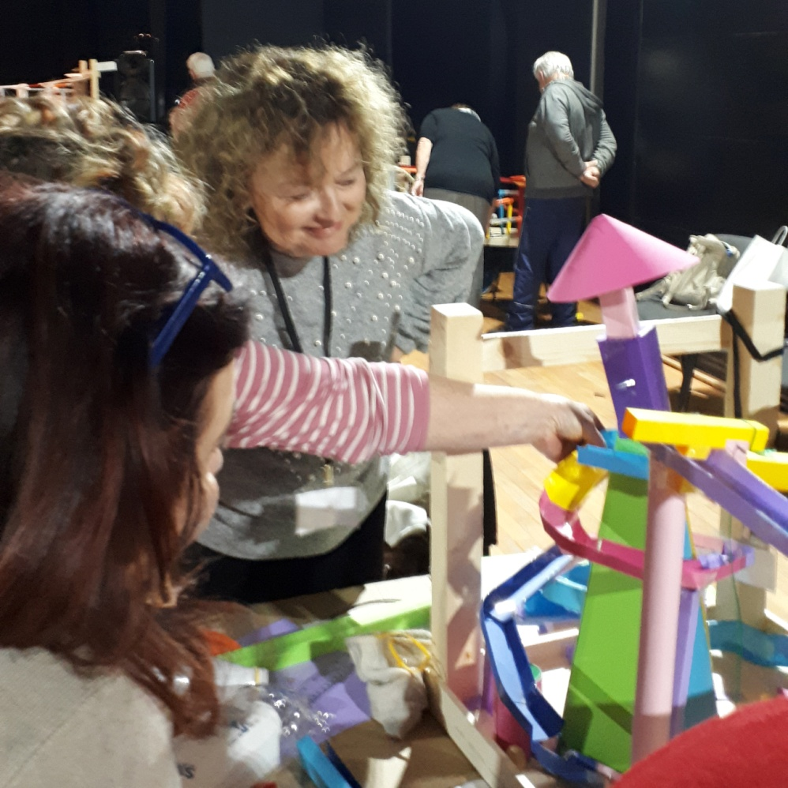
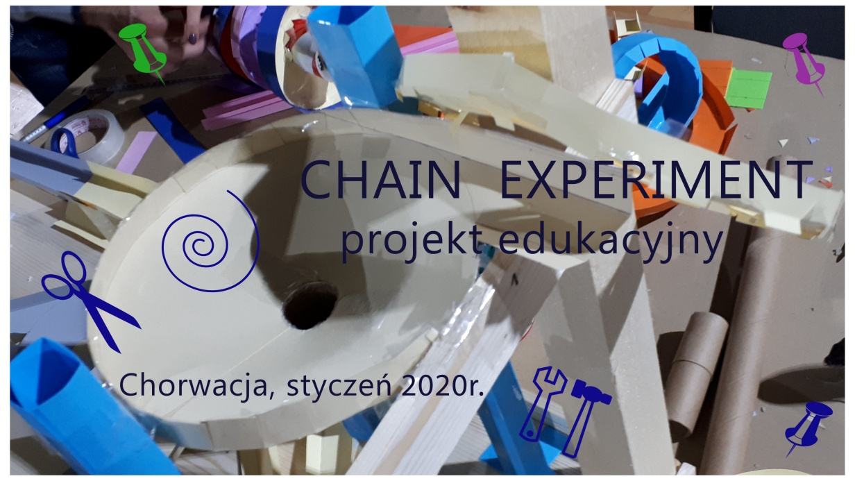

Each group develops its own track.

Slide 24
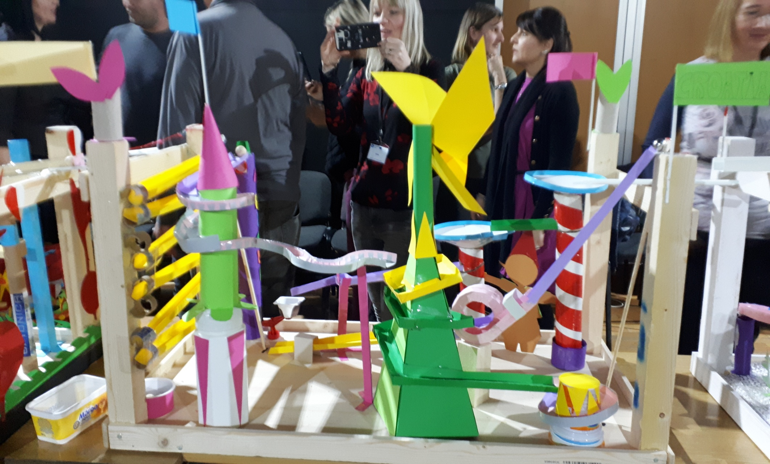
Each team is ready for the final presentation.

Slide 25
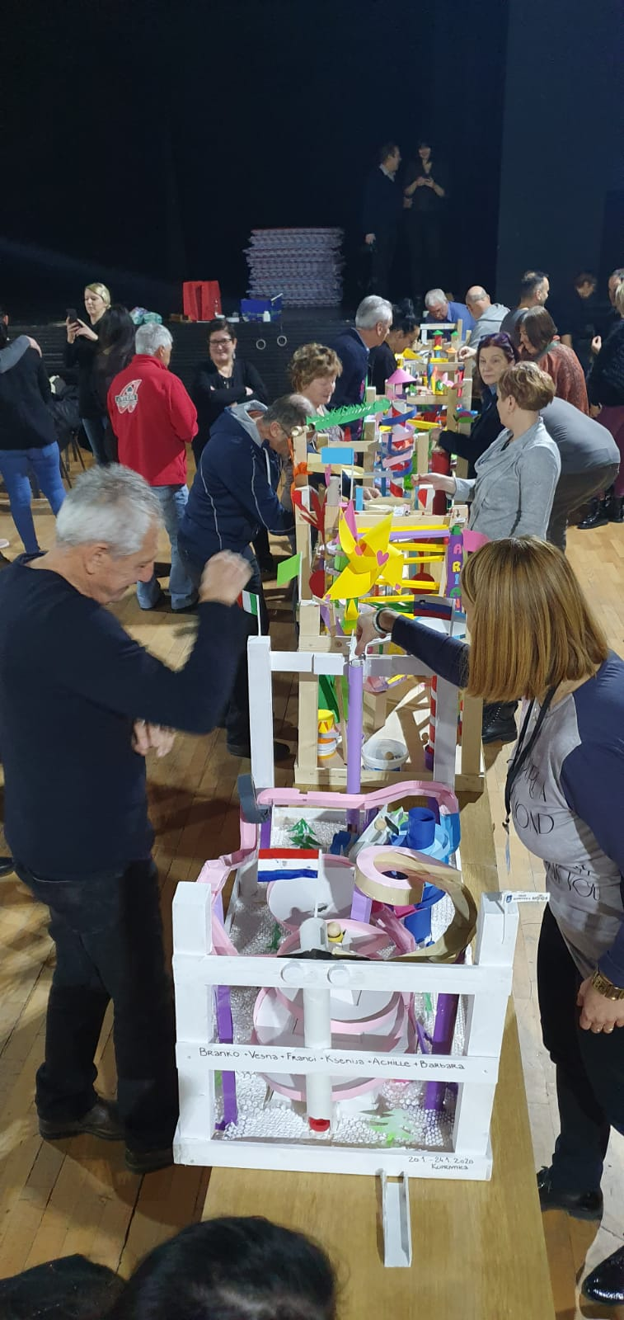

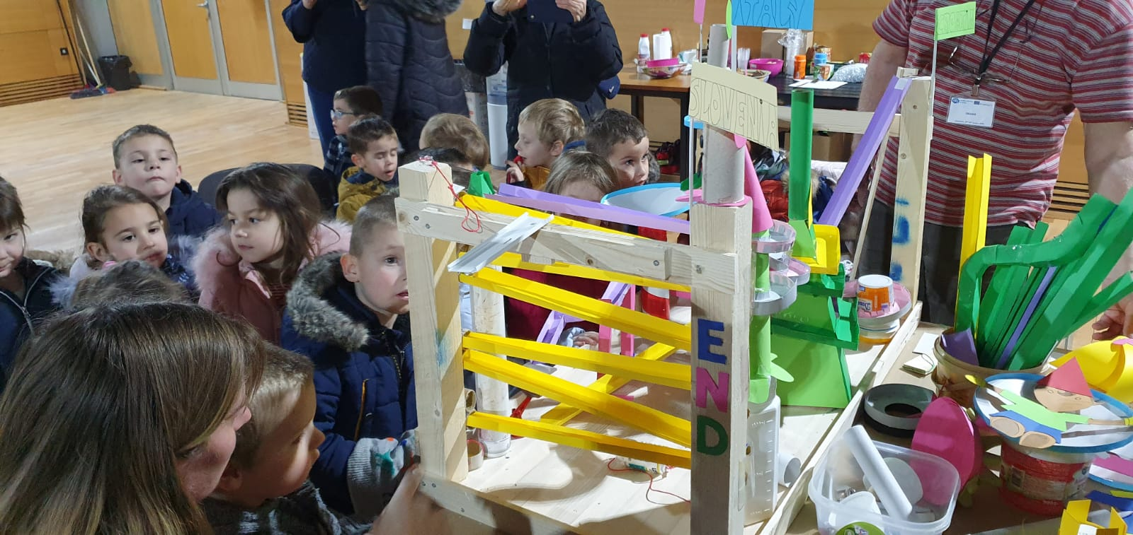
The Final Presentation
Chain Experiment

